Slide 1
Chapter 4
Induction and Recursion
Quy nạp và Đệ quy

Slide 2
Objectives
Mathematical Induction
Strong Induction and Well-Ordering
Recursive Definitions and Structural Induction
Recursive Algorithms
Program Correctness

Slide 3
4.1- Mathematical Induction
Introduction
Mathematical Induction
Examples of Proofs by Mathematical Induction

Slide 4
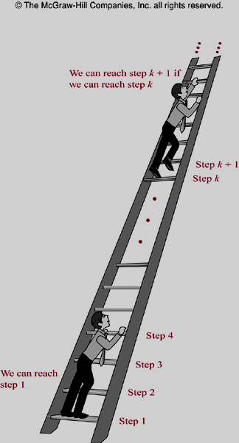
Principle of Mathematical Induction
Principle of Mathematical Induction
To prove P(n) is true for all possible integers n, where P(n) is a propositional function, we complete two step:
Basic step:
Verifying P(1) is true
Inductive step:
Show P(k) → P(k+1) is true for all k>0

Slide 5
Induction: Example 1
Prove that 1 + 2 + 3+ …+ n = n(n+1)/2 for all integers n>0
Solution.
Let P(n)=“ 1+2+3+…+ n = n(n+1)/2”.
Basic step: P(1) = “1 = 1(1+1)/2” ➔ true
Inductive step: With arbitrary k>0,
P(k) =“ 1+ 2+…+ k = k(k+1)/2” is true.
We have
1+2+3+…+k+(k+1)= k(k+1)/2 + (k+1)
= [k(k+1)+ 2(k+1)]/2
= (k+1)(k+2)/2
= (k+1)((k+1)+1)/2
P(k+1)=“1+2+3+…+k+1 = (k+1)(k+2)/2” is true.
P(k) → P(k+1): true
Proved.

Slide 6
Example 2 p.268
Conjecture a formula for the sum of the first n positive odd integers. Then prove your conjecture using mathematical induction.
Solution.
The sum of the first n positive odd integers for n=1, 2, 3, 4, 5 are:
1=1, 1+3=4, 1+3+5=9,
1+3+5+7=16, 1+3+5+7+9=25.
Conjecture: 1+3+5+…+(2n-1)=n².
Proof. Let P(n)=“1+3+5+…+(2n-1)=n².”
- Basic step. P(1)=“1=1” is true.
- Inductive step. (P(k) P(k+1)) is true.
Suppose P(k) is true. That is, “1+3+5+…+(2k-1)=k²”
We have, 1+3+5+…+(2k-1)+(2k+1)=k²+2k+1 = (k+1)².
So, P(k+1) is true.
Proved.

Slide 7
Induction: Examples 2..13 – pages: 268..278
1+3+5+…+ (2n-1) = n²
2⁰+2¹+2²+2³+…+2^{n} = ∑ 2^{n} = 2^{n+1} -1
∑ar^{j} = a + ar + ar²+ … + ar^{n} = (ar^{n+1}-a)/(r-1)
n < 2^{n}
2^{n} < n! , n>3
n³-n is divisible by 3, n is positive integer
The number of subsets of a finite set: a set with n elements has 2^{n} subsets.
….
Let H(j)= 1/1 + ½ + 1/3 + … + 1/j
Prove that H(2^{n})  1 + n/2 for all n  0

Slide 8
4.2- Strong Induction and Well-Ordering
Principle of Strong Induction
To prove P(n) is true for all positive integers n, where P(n) is a propositional function, two steps are performed:
Basic step:
Verifying P(1) is true
Inductive step:
Show [P(1) ^ P(2) ^ … ^ P(k)] → P(k+1) is true for all k>0

Slide 9
Strong Induction: Example 1
Prove that if n is an integer greater than 1, then n can be written as the product of primes
P(n) : n can be written as the product of primes
Basic steps: P(2) = true // 2=2 , product of 1 primes
P(4) = true // 4=2.2
Inductive step:
Assumption: P(j)=true for all positive j ≤ k
Case k+1 is a prime ➔ P(k+1) =true
Case k+1 is a composite ➔ k+1= ab, 2 ≤ a ≤ b<k+1
➔ P(k) is true

Slide 10
Strong Induction: Example 2
Prove that every amount of postage of 12 cents or more can be formed using just 4-cents and 5-cents stamps
P(n) : “ n cents can be formed using just 4-cent and 5-cent stamps”
P(12) is true : 12 cents = 3. 4 cents
P(13) is true : 13= 2.4 + 1.5
P(14) is true: 14= 1.4 + 2.5
P(15) is true: 15= 3.5
Assumption: P(j) is true with 12 ≤j ≤ k, k>15 ➔ P(k-3) is true
k+1= (k-3) + 4 , k>12
P(k+1) is true because k+1 is the result of adding a 4-cent stamp to the amount k-3
Proved

Slide 11
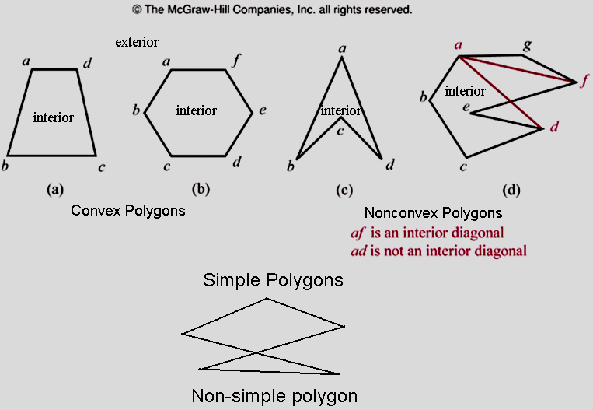
Using Strong Induction in Computational Geometry
Definitions

Slide 12
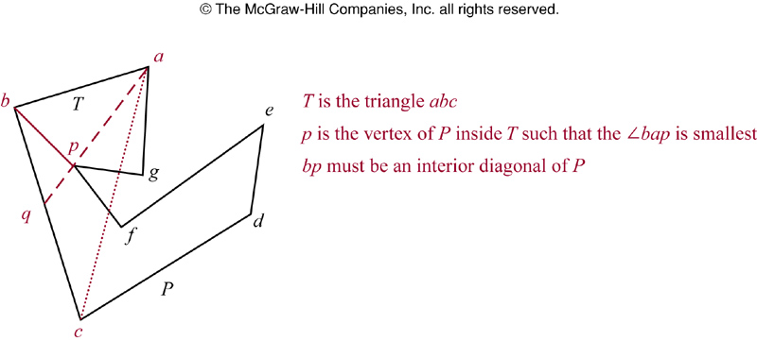
Strong Induction in Computational Geometry
Lemma 1: Every simple polygon has an interior diagonal.
Proof: page 290

Slide 13
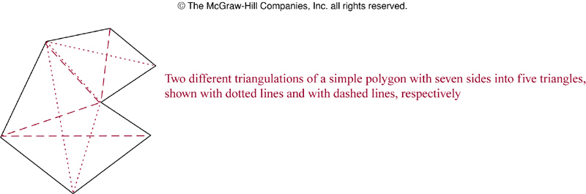
Strong Induction in Computational Geometry
Theorem 1:
A simple polygon with n sides, where n is integer with n ≥ 3, can be triangulated into n-2 triangles
Proof: page 289

Slide 14
4.3- Recursive Definition and
Structural Induction
Introduction
Recursively Defined Functions
Recursively Defined Sets and Structures
Structural Induction
Generalized Induction
Recursive Algorithms

Slide 15
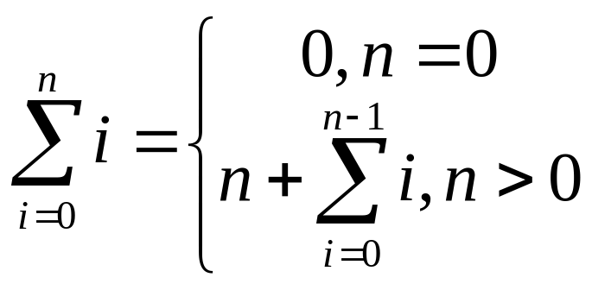
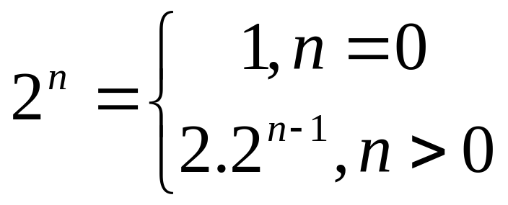
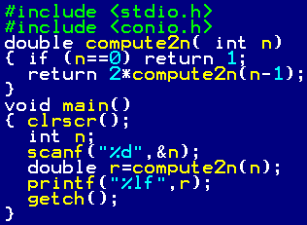
Recursion: Introduction
Objects/ functions may be difficultly defined.
Define an object/function in terms of itself
Examples:

Slide 16
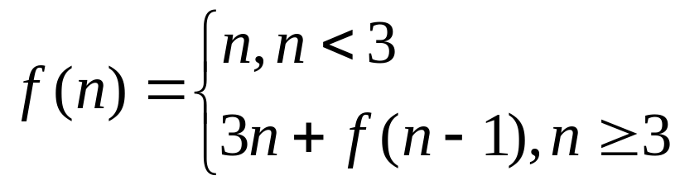
Recursively Defined Functions
Recursive ( inductive) function
Two steps to define a function with the set of nonnegative integers as its domain:
Basis step: Specify the value of the function at zero.
Recursive step: Give a rule for finding its value at an integer from its values at smaller integers
Example: Find f(1), f(2), f(4),f(6) of the following function:

Slide 17
Recursively Defined Functions
Example: Give the recursive definition of ∑a_{i} , i=0..k
Basis step: ∑a_{i} =a₀, i=0
Inductive step:
a₀ + a₁ + … + a_{k-1} + a_{k}
( ∑a_{i} , i=0..k-1)
∑a_{i} =a_{k} + ( ∑a_{i} , i=0..k-1)

Slide 18
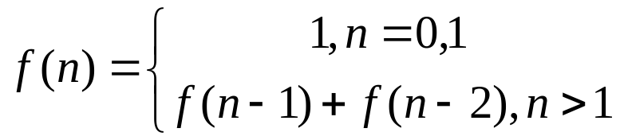
Recursively Defined Functions
Definition 1: Fibonacci numbers
Theorem 1: Lamé’s theorem: Let a,b be integers, a ≥ b. Then the number of divisions used by the Euclidean algorithm to find gcd(a,b) is less than or equal to five times the number of decimal digits in b.
Proof: page 298
Example gcd(25,7), b= 7 , 1 digit
x y r
25 7 25 mod 7=4
7 4 7 mod 4=3
4 3 4 mod 3=1
3 1 3 mod 1=0 ( 4 divisions)
1 0 Stop
procedure gcd(a,b)
x:=a; y:=b
while y ≠ 0
begin
r := x mod y
x:=y
y:= r
end { gcd(a,b) is x}

Slide 19
Recursively Defined Sets and Structures
Example S= { 3,6,9,12,15, 18,21,…}
Step 1: 3∈S
Step 2: If x∈S and y∈S then x+y∈S
Definition 2: The set ∑* of string over alphabet ∑ can be defined recursively by:
Basis step: λ ∈ ∑*, λ is the empty string with no symbols
Recursive step: If w∈ ∑* and x∈ ∑ then wx∈ ∑*
Example: ∑ ={0,1} ➔ ∑* is the set of string made by 0 and 1 with arbitrary length and arbitrary order of symbols 0 and 1

Slide 20
Recursively Defined Sets and Structures
Definition 3: String Concatenation
Basis step: If w ∈ ∑* then w.λ=w, λ is the empty string
Recursive step: If w₁∈ ∑* and w₂∈ ∑* and x∈ ∑ then w₁.(w₂x) =(w₁.w₂)x
Example: ∑ ={0,1} ➔ ∑* is the set of string made by 0 and 1 with arbitrary length and arbitrary order of symbols 0 and 1

Slide 21
4.4- Recursive Algorithms
Definition 1: An algorithm is called recursive if it solves a problem by reducing it to an instance of the same problem with smaller input.
Example: Recursive algorithm for computing n!
procedure factorial (n: nonnegative integer)
if n=0 then factorial(n) :=1
else factorial(n) = n.factorial(n-1)
n!= 1 , n=0
n!= 1.2.3.4…n = n.(n-1)!, n>0

Slide 22
Recursive Algorithms…
Example: Recursive algorithm for computing a^{n}
procedure power (a: nonzero real number
n: nonnegative integer)
if n=0 then power(a,n) :=1
else power(a,n)=a.power(a,n-1)
a^{n}= 1 , n=0
a^{n}= a.a.a…a = a.a^{n-1}, n>0

Slide 23
Recursive Algorithms…
Example: Recursive algorithm for computing b^{n} mod m m ≥ 2, n ≥ 0, 1 ≤ b < m.
b^{n} mod m = (b.(b^{n-1} mod m) mod m
b⁰ mod m = 1
Using division to improve performance: ( n steps backward to 0 faster)
If n is even → b^{n} = b^{n/2}.b^{n/2}
→ b^{n} mod m = ((b^{n/2} mod m). (b^{n/2} mod m)) mod m
→ b^{n} mod m = (b^{n/2} mod m)² mod m
If n is odd→ b^{n} = b.b ^{⎣n/2⎦}.b ^{⎣n/2⎦}
→ b^{n} mod m = ([(b ^{⎣n/2⎦} mod m)² mod m].(b mod m))mod m
Algorithm: page 313

Slide 24
Recursive Algorithms…
Example: Recursive algorithm for computing gcd(a,b) a,b: non negative integer, a < b
If a>b then swap a,b
gcd(a,b)=b , a=0
gcd (a,b) = gcd(b mod a, a)
Algorithm: page 313

Slide 25
Recursive Algorithms…
Example: Recursive algorithm for linear searching the value x in the sequence
a_{i}, a_{i+1},…, a_{j}, sub-sequence of a_{n}.
1≤ i ≤ n, 1 ≤ j ≤ n
i>j → location =0
a_{i}=x → location = i
location (i, j, x) = location ( i+1, j, x)
Algorithm: page 314 – You should modify it.

Slide 26
Recursive Algorithms…
Example: Recursive algorithm for binary searching the value x in the increasingly ordered sequence a_{i}, a_{i+1},…, a_{j-1}, sub-sequence of a_{n}. 1≤ i ≤ n, 1 ≤ j ≤ n
1≤ i ≤ n, 1 ≤ j ≤ n
procedure binary-search(x, i, j)
if i>j then location=0
m= ⎣(i+j)/2⎦
if x= a_{m} then location =m
else if x< a_{m} then location= binary-search(x, i, m-1)
else location= binary-search(x, m+1, j)
Algorithm: page 314 – You should modify it.

Slide 27
Proving Recursive Algorithms Correct
Using mathematical induction.
Example: prove the algorithm that computes n! is correct.
procedure f (n: nonnegative integer)
if n=0 then f(n) :=1
else f(n) = n.f(n-1)
If n=0, first step of the algorithm tells us f(0)=1 ➔ true
Assuming f(n) is true for all n≥0
f( n)= 1.2.3….(n)
(n+1).f(n)= 1.2.3…n.(n+1) = (n+1)!
f(n+1) = (n+1)!
Conclusion: f(n) is true for all integer n, n≥0
More examples: Page 315

Slide 28
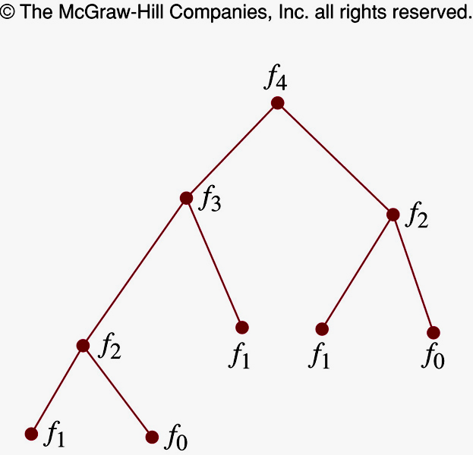
Recursion and Iteration
procedure rfibo (n: nonnegative integer)
If n=0 then rFibo(0)=0
Else if n=1 then rFibo(1)=1
Else rFibo(n) := rFibo(n-2) + rFibo(n-1)
procedure iFibo (n: nonnegative integer)
If n=0 then y:=0
Else if n=1 then y:=1
Else Begin
x:=0 ; y:=1
for i:= 2 to n
Begin
z:= x+y; x:= y; y:=z
End
End { iFibo(n) = z}
Recursive algorithm uses far more computation than iterative one

Slide 29
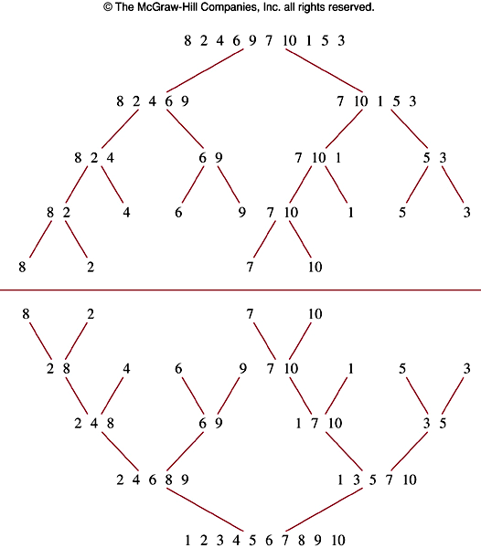
Merge Sort
Procedure mergeSort (
L=a₁…a_{n})
If n>1 then
Begin
m:= ⎣n/2⎦
L1 := a₁…a_{m}
L2 := a_{m+1}…a_{n}
L:=merge(mergeSort(L1),mergeSort(L2))
End
{L is sorted}
Merge?

Slide 30

Merge Sort
L1: 1 2 2 5 7 9 12 15 17 19
L2: 3 5 8 9 11 15
≤
L : 1 2 2 3 5 5 7 8 9 9 11 12 15 15 17 19
Merge two sorted lists L1, L2 to list L, an increasing ordered list.
procedure Merge (L1, L2: sorted list)
L:= empty list
While L1 and L2 are both no empty
Begin
remove smaller of first element of L1 and L2
and put it to the right end of L
if removal of this element makes one list empty then remove all elements from the other list and append them to L
End { L has increasing order }
Theorem 1: The number of comparisons needed to merge sort a list with n elements is O(nlog n)

Slide 31
Thanks

